Slide 1
Department of CSE,CSIT
COURSE NAME: Data science
COURSE CODE: 23SC3201
Topic:
DATA COLLECTION METHODS
Session - 4

Slide 2



AIM OF THE SESSION
To familiarize students with the basic concept of DATA COLLECTION METHODS in Data science
INSTRUCTIONAL OBJECTIVES
This Session is designed to: Introduction about DATA COLLECTION METHODS in Data Science
LEARNING OUTCOMES
At the end of this session, you should be able to: basic knowledge about DATA COLLECTION METHODS

Slide 3
Data Collection Methods
Data collection is a process of collecting data from different sources to do research or explore it for different purposes. It helps to find business insights or data insights. Some of the common examples of data analysis are social sciences, business, and healthcare.
There are two types of data collection −
Primary data collection
Secondary data collection

Slide 4
Data Collection Methods
1. Primary Data Collection
It collects responses or data directly from users.
After collecting data; it may processed by computer systems to remove noises and organise it to analyze it.
Primary data collection is critical in research because it enables specific data collection, relevant, and up-to-date information that directly addresses the research question or objective.
Accurate
Fresh
Specific to the requirement
However, it can be:
Expensive
Time-consuming

Slide 5
Data Collection Methods
Methods of Collecting Primary Data
Surveys and Questionnaires − This is one of the primary methods to collect data using structured questionnaires or surveys from individuals or groups. This method also includes face-to-face interviews and telephone calls.
Example: Amazon sends surveys asking customers:
Product quality
Delivery experience
Service satisfaction
The collected data helps improve customer service.
Interviews − It is a method which includes direct interaction between the researcher and the respondent. They can be done in person, over the phone, or via video conferencing. It can be structured, semi-structured, or unstructured.

Slide 6
Data Collection Methods
Types of Interviews
1. Structured Interview - Fixed questions are asked.
2. Unstructured Interview - Open discussion without fixed questions.
3. Semi-Structured Interview - Combination of fixed and flexible questions.
Example: Healthcare Research
Doctors interview patients regarding:
Symptoms
Medical history
Treatment effectiveness
This information helps improve diagnosis systems.

Slide 7
Data Collection Methods
Observations − This method observes and records behaviours in the natural environment. This method is useful for acquiring information about human behaviour, interactions, and occurrences without requiring direct intervention.
Types of Observation
1. Direct Observation - Observer watches events directly.
2. Indirect Observation - Uses devices such as cameras or sensor
Example: Retail Store Analytics
Stores monitor:
Customer movement
Product interactions
Purchase behavior
to optimize product placement

Slide 8
Data Collection Methods
Experiments − This method includes variable manipulation and observes their impact on the outcome.
Example: Pharmaceutical Testing
Drug companies test medicines on clinical trial groups to measure:
Effectiveness
Side effects
Safety
Focus Groups − This method involves data gathering using a small group of people to discuss a particular topic and record the outcomes.
Example: Product Testing
Mobile companies gather user feedback before launching smartphones.
Case Studies − It is a method to study a single case or multiple cases to find feasible solutions.
Field Studies − It is a method of testing a product or process in the real world.

Slide 9
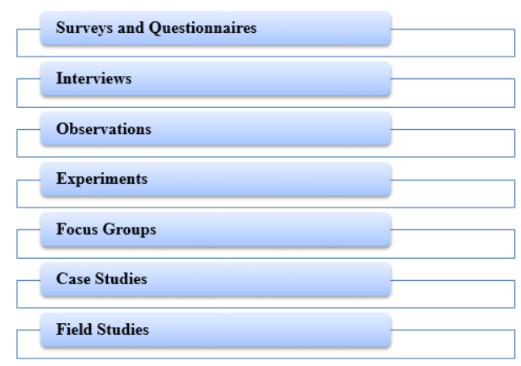
Data Collection Methods
Sensor-Based Data Collection - Sensors automatically collect real-time data from environments or devices.
Example: Smartwatch Health Monitoring
Smartwatches collect:
Heart rate
Sleep data
Step count
This data is analyzed for health monitoring.

Slide 10
Data Collection Methods
2. Secondary Data Collection
Secondary data collection is a method of collecting data from different resources where data or information already exists.
This data collection method is very popular and most widely used in research.
This type of data is commonly employed when primary data collection is unfeasible, time-consuming, or unneeded.
It can be useful for gathering background information, enriching primary data, or doing data analysis when primary data is unavailable.
For example marketing trend changes over time; so, if anyone is doing research in this reference, they need to collect secondary data on marketing trends during previous years and then do research and comparison with current marketing trends.

Slide 11
Data Collection Methods
Methods of Collecting Secondary Data
Published Research / Existing research − This includes research articles published in academic journals, conferences, magazines, books, newspapers, and other published materials that contain relevant data. Research studies and their findings can be useful as secondary data sources. Researchers can evaluate and analyse the data to gain new insights or expand existing information with new insights.
Data sources on the internet − It includes information available on the internet. It is considered as secondary data.
Online Databases − Online databases that provide access to research articles, statistical information, economic data, and social surveys.
Industry Reports − These include market research reports, industry trends, and current and future industrial trends.

Slide 12
Data Collection Methods
Government and Institutional Reports − From time to time, the Government processes its data and releases reports like reports on Census data, economic reports, and health statistics which can be further utilised as a secondary source of data to do research. These institutions maintain databases or records that can be used for research purposes.
Social Media Data or Publicly Available Data − Data available on social media sites(twitter, facebook) can also considered secondary data. Like sentiments data is most widely used in doing NLP and machine learning research. Data shared by individuals, organizations, or communities on public platforms, websites, or social media can be accessed and utilized for research.

Slide 13
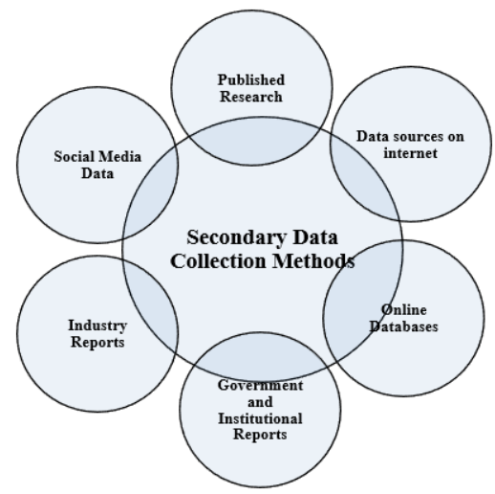
Data Collection Methods

Slide 14
Key Terms Related to Data Collection
understanding essential data collection terms ensures clarity in research, analytics, and AI-driven applications. Below are key concepts that play a crucial role in data quality and interpretation.
Population vs. Sample
Population: The entire group from which data is collected. Example: A survey conducted on all customers of an e-commerce platform.
Sample: A subset of the population used for analysis. Example: Surveying 1,000 customers from a million-user database.
A well-chosen sample ensures that conclusions are representative of the entire population, reducing time and costs while maintaining accuracy.

Slide 15
Raw Data vs. Processed Data
Raw Data: Unstructured, unfiltered information directly collected from sources.
Example: Sensor readings, survey responses, or web traffic logs.
Processed Data: Cleaned, structured, and analyzed data ready for use. Example: Formatted reports, dashboards, and machine learning datasets.
Processed data removes inconsistencies and enhances insights for decision-making and predictive analytics.
Accuracy, Reliability, and Validity
Accuracy: How close data is to the actual or true value.
Reliability: Consistency in results when data is collected repeatedly.
Validity: Whether the data measures what it’s intended to measure.

Slide 16
Types of Data Sources
1. Primary Data
Primary data is collected firsthand through surveys, experiments, or observations. This type of data is highly specific to the problem at hand and allows for greater control over the data-gathering process.
Examples: Surveys conducted via online platforms, laboratory experiments, and field observations.
2. Secondary Data
Secondary data refers to information that has already been collected by others and is made available for analysis. It is often used to complement primary data or provide a broader context.
Examples: Public datasets from government databases, research publications, and data shared by organizations like the World Bank.

Slide 17
3. Real-time Data
Real-time data is continuously generated and collected from sources like IoT devices, live feeds, or streaming platforms. This data is invaluable in applications requiring up-to-the-minute information.
Examples: IoT sensor data, live social media feeds, and streaming weather data.

Slide 18
Methods of Data Collection in Data Science
There are various methods for collecting data in data science, each suited to different types of projects and data needs. Here are the most common methods:
1. Surveys and Questionnaires
Surveys and questionnaires are among the most widely used methods for gathering data directly from individuals or groups. These tools are particularly effective for collecting qualitative data such as opinions, preferences, and feedback.
When and How to Use: Surveys should be carefully designed to minimize bias, ensuring that the questions asked are relevant, clear, and objective. Surveys can be distributed digitally through platforms like Google Forms, SurveyMonkey, or Typeform. Proper design and deployment of surveys can lead to meaningful insights from targeted demographics.
Challenges: The accuracy of survey data heavily depends on the quality of the questions and the honesty of the respondents. Sampling bias and low response rates are common challenges that can skew the result

Slide 19
2. Web Scraping
Web scraping is the process of automatically extracting data from websites. This method is particularly useful when data is not readily available through APIs or structured databases.
Tools and Techniques: Popular web scraping tools include Beautiful Soup, Selenium, and Scrapy. These tools allow for automated extraction of data from web pages, which can then be processed and analyzed.
Challenges: Web scraping comes with legal and ethical considerations, as some websites may restrict data extraction. Moreover, scraping often requires cleaning and structuring the data before it can be analyzed.

Slide 20
3. APIs (Application Programming Interfaces)
APIs provide a structured way to access data from various platforms. They are a popular method for collecting real-time data from social media platforms, financial markets, and other online services.
Using APIs: APIs such as the Twitter API, Google Maps API, and OpenWeather API are widely used in data science projects for collecting data. APIs provide a standardized format, making data collection easier and more efficient than web scraping.
Challenges: API data collection often involves handling rate limits, formatting issues, and processing large amounts of data, all of which can slow down the analysis process.

Slide 21
4. IoT and Sensor Data
IoT and sensor data are collected from physical devices connected to the internet. This type of data collection is particularly relevant for real-time applications such as predictive maintenance, health monitoring, and environmental tracking.
Overview: IoT sensors generate continuous streams of data that can be used to monitor conditions, detect anomalies, and predict future outcomes. For example, smart home devices can collect data on energy consumption or room temperature in real-time.
Challenges: The large volume of data generated by IoT devices requires robust infrastructure for storage, processing, and analysis. Additionally, ensuring the accuracy and security of IoT data is a common concern.

Slide 22
5. Databases as a Data Collection Method
Definition
A database is an organized collection of data stored electronically and managed using Database Management Systems (DBMS). Databases are used to store, retrieve, update, and manage large amounts of structured data.
Types of Databases
a) Relational Databases
Data is stored in tables (rows and columns)
Uses SQL (Structured Query Language)
Examples
MySQL
Oracle Database
Microsoft SQL Server

Slide 23
b) NoSQL Databases
Stores unstructured or semi-structured data
Suitable for big data and real-time applications
Examples
MongoDB
Apache Cassandra
Redis
How Databases Collect Data
Data enters databases through:
Online forms
Business applications
Sensors and IoT devices
Mobile applications
Transaction systems
APIs

Slide 24
7.Web Data as a Data Collection Method
Definition
Web data refers to information collected from websites, web applications, online platforms, and internet services.
Sources of Web Data
Websites
Social media platforms
Blogs and forums
Online surveys
E-commerce sites
News portals

Slide 25
Methods of Collecting Web Data
a) Web Scraping
Automatically extracting information from websites.
Tools Used
Beautiful Soup
Scrapy
Selenium
b) APIs (Application Programming Interfaces)
APIs allow applications to access web data directly.
Examples
Google API
X API
Facebook Graph API

Slide 26
c) Web Forms and Surveys
Users submit information through online forms.
Examples
Registration forms
Feedback forms
Online polls

Slide 27
Step-by-Step Guide to Data Collection
Conducting effective data collection requires a systematic approach. Below is a step-by-step guide to ensure the data you collect is useful and accurate:
Define the Problem Statement: Begin by clearly defining the business or research problem. Understanding what you aim to solve will help guide the entire data collection process, ensuring that only relevant data is gathered.
Determine the Type of Data Needed: Decide whether you need qualitative or quantitative data, or perhaps a mix of both. Additionally, you should determine whether you need structured data (e.g., tabular data) or unstructured data (e.g., text, images).
Select Data Sources: Based on the type of data needed, identify whether primary, secondary, or real-time data sources are most appropriate. For example, if you need data on customer behavior, web scraping or API data may be more suitable than surveys.

Slide 28
Create a Timeline for Data Collection: Establish a clear timeline for when and how the data will be collected. Define specific checkpoints to track progress and address any issues that arise during the data collection process.
Collect and Validate Data: As you collect data, ensure that it is clean and valid. Validation techniques include checking for inconsistencies, correcting errors, and handling missing data to avoid issues during the analysis phase.

Slide 29
Example of Data Collection in Practice
Consider an e-commerce company looking to improve customer experience. The company collects data through:
Primary Data Collection: Conducting customer surveys to gather direct feedback on shopping experience, website usability, and product preferences.
Secondary Data Collection: Analyzing existing data sources, such as Google Analytics, purchase history, and social media reviews, to identify trends and customer behavior.
By combining primary and secondary data, the company gains comprehensive insights into customer satisfaction and areas for improvement.

Slide 30
Case Study: Data-Driven Decision-Making
A retail chain used data collection and analytics to optimize store layouts and inventory management.
Process:
Installed smart sensors to track foot traffic patterns.
Collected POS (Point-of-Sale) transaction data to identify high-demand products.
Analyzed customer purchase behavior using AI-driven predictive models.
Results:
Rearranged store aisles to maximize accessibility to popular products.
Adjusted inventory to reduce overstocking and shortages.
Increased sales by 15% through personalized promotions based on collected data.

Slide 31
Terminal Questions
1. What is data collection, and why is it important?
2. What are the different methods of data collection?
3. What are the key tools used in data collection?
4. How do I choose the right data collection method for my research?

Slide 32

THANK YOU
Team – DS

